Slide 1


The Improvements of Flight Safety
Taylor Anderson

Slide 2
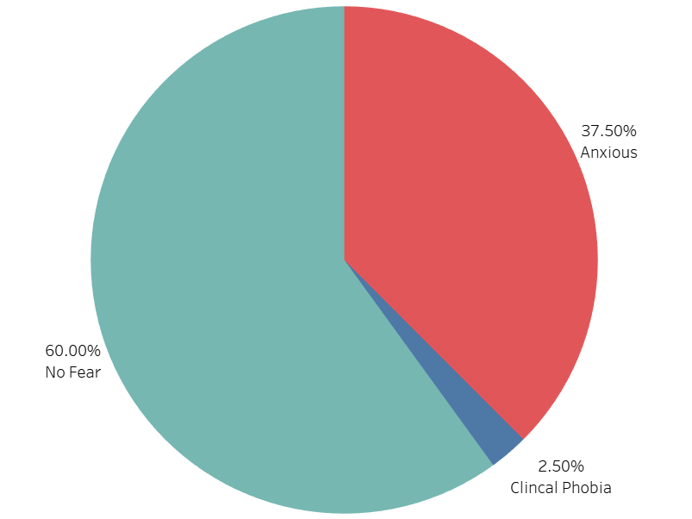

Slide 3
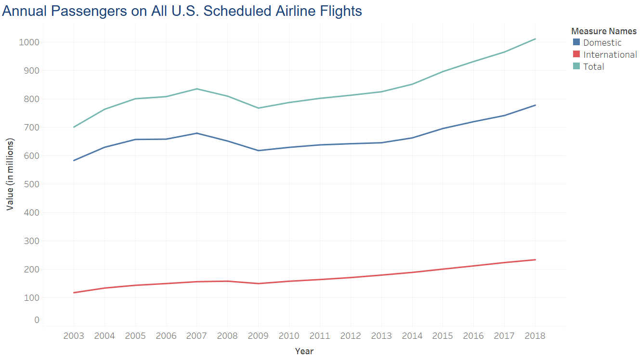

Slide 4
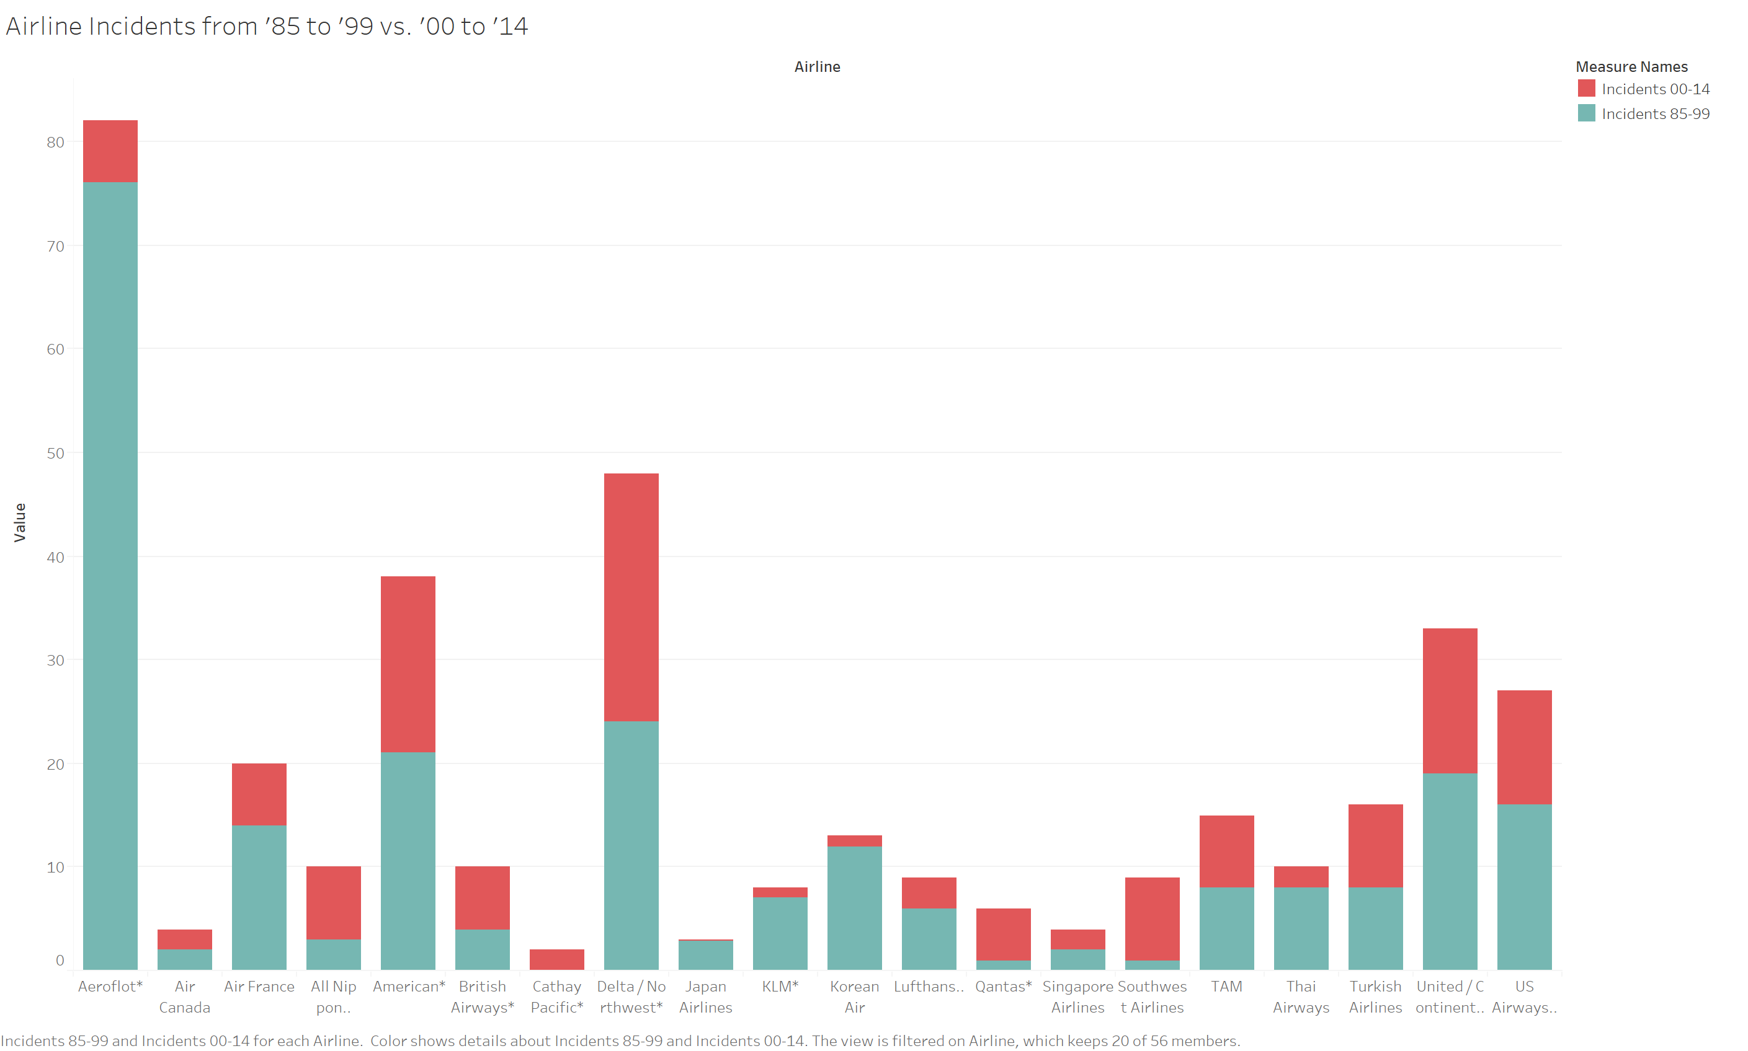

Slide 5
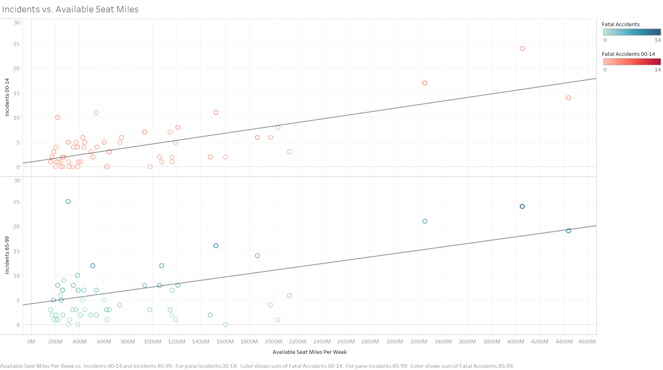

Slide 6
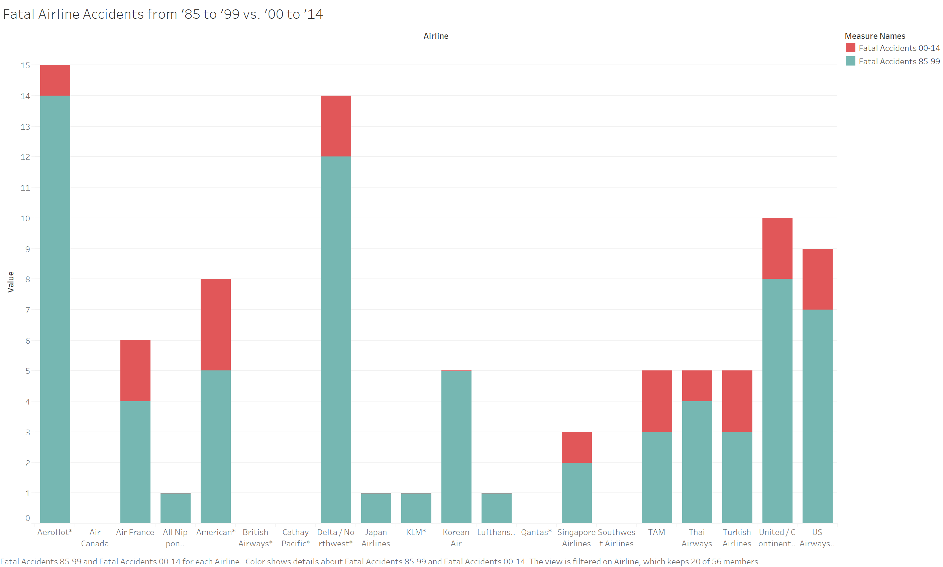

Slide 7
Conclusion
Fear of flying is very common
Number of passengers each year has increased
Incidents have reduced over time
Fatalities have decreased

